Slide 1

SlideKiln
This is a PowerPoint.
Built in PowerPoint. Converted by SlideKiln.
Now running as HTML5 in your browser.
Click, tap or press → to continue

Slide 2
CHOOSE A STOP
Every link on this slide jumps to another slide
Video
Embedded video that plays in place
Go →
Animations
Click-by-click builds and emphasis
Go →
Morph
Objects glide between slides
Go →
Charts
Native charts, not screenshots
Go →
…or just keep clicking through in order.
Built in PowerPoint · converted by SlideKiln

Slide 3
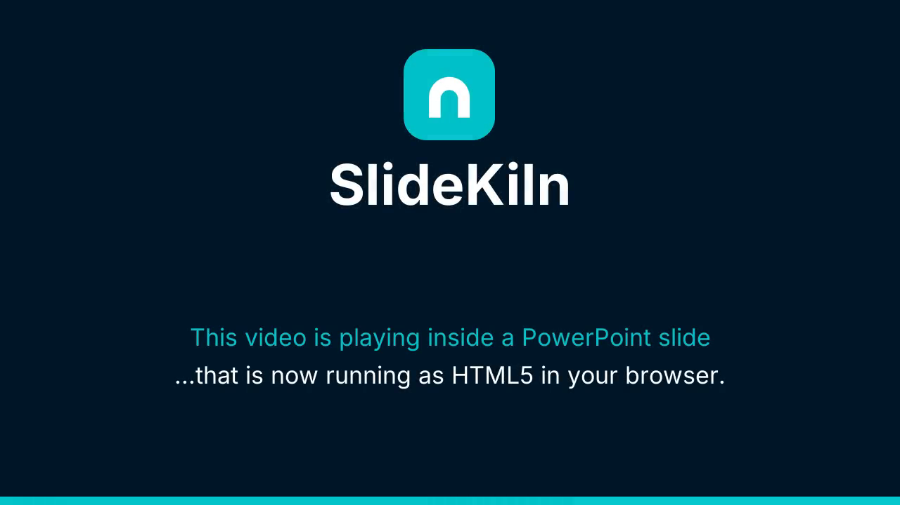
VIDEO
The video lives inside the deck
Press play.
The .mp4 was embedded in PowerPoint the normal way. SlideKiln carries it into the HTML package, so it plays right here, with no YouTube link and no plugin.
Built in PowerPoint · converted by SlideKiln
← Menu

Slide 4
ANIMATIONS
Click to build this slide
1
Fade in
Click once.
2
Fly in
Click again.
3
Wipe
And once more.
Timing, order and emphasis all survive.
Built in PowerPoint · converted by SlideKiln
← Menu

Slide 5
MORPH
Decks on most platforms: a mess of screenshots
Click to morph →
← Menu

Slide 6
MORPH
With SlideKiln: every slide, in its place
Slide 1
Slide 2
Slide 3
Slide 4
Slide 5
Slide 6
← Menu

Slide 7
CHARTS
This chart is real data, not a picture
What survives the trip to the web?
Image previews keep the layout and lose the rest. SlideKiln keeps all four.
The chart itself is drawn from the data inside the .pptx, as crisp vectors that stay sharp at any zoom.
Built in PowerPoint · converted by SlideKiln
← Menu

Slide 8
Everything you just clicked was a .pptx.
Put your own decks on the web, or inside your product, the same way.
Convert your first deck free →
slidekiln.com
← Menu

